Slide 1

Customer Shopping Behavior Analysis
This comprehensive analysis examines customer shopping behavior using transactional data from 3,900 purchases across various product categories. Our goal is to uncover actionable insights into spending patterns, customer segments, product preferences, and subscription behavior to guide strategic business decisions and drive revenue growth.

Slide 2

Dataset Overview
3,900
Key Features Analyzed
Customer Demographics: Age, Gender, Location, Subscription Status
Total Purchases
Purchase Details: Item Purchased, Category, Purchase Amount (USD), Season, Size, Color
Comprehensive transaction records analyzed
Shopping Behavior: Discount Applied, Promo Code Used, Previous Purchases, Frequency of Purchases, Review Rating, Shipping Type
18
Data Quality Note: 37 missing values identified in Review Rating column, handled through median imputation by product category
Data Columns
Rich feature set for analysis
50
Locations
Geographic diversity in customer base
25
Products
Diverse product catalog

Slide 3
Data Preparation & Engineering
We employed a rigorous data preparation process using Python to ensure data quality and create meaningful features for analysis. This foundation was critical for generating reliable insights.
01
02
Data Loading & Exploration
Missing Data Handling
Imported dataset using pandas, performed initial exploration with df.info() and .describe() to understand structure and summary statistics
Identified null values and imputed missing Review Rating values using median rating of each product category to maintain data integrity
03
04
Column Standardization
Feature Engineering
Renamed all columns to snake_case format for improved readability and consistent documentation standards
Created age_group column by binning customer ages and purchase_frequency_days column from purchase data for deeper segmentation
05
06
Data Consistency
Database Integration
Verified redundancy between discount_applied and promo_code_used fields; dropped promo_code_used to eliminate duplication
Connected Python script to PostgreSQL and loaded cleaned DataFrame into database for structured SQL analysis

Slide 4
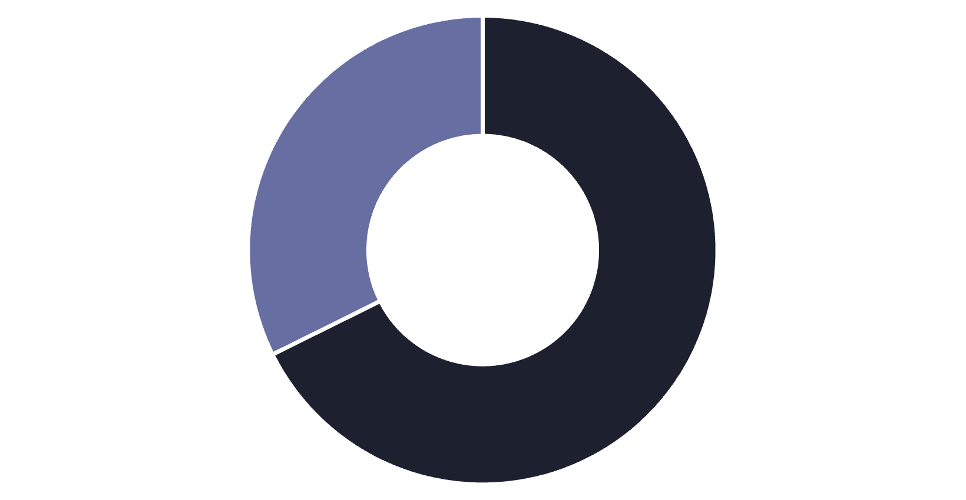

Revenue Analysis by Gender
Male Customers Drive Revenue
Male customers generated $157,890 in total revenue compared to $75,191 from female customers, representing a significant 68% of total revenue despite making up 68% of the customer base.
This gender distribution suggests opportunities for targeted marketing campaigns to better engage female customers and balance revenue streams across demographics.
Male
Female
Strategic Insight: Consider developing gender-specific product lines and marketing strategies to increase female customer engagement and spending

Slide 5
High-Value Discount Users
We identified a valuable customer segment: 839 customers who used discounts but still spent above the average purchase amount of $59.76. This represents 21.5% of all customers and reveals a sophisticated shopper profile.
Strategic Shoppers
Premium Opportunity
Loyalty Potential
These customers actively seek value through discounts while maintaining high purchase amounts, indicating they're not just bargain hunters but strategic buyers
Purchase amounts ranged from $62 to $97, well above average, suggesting these customers buy premium items even with discounts applied
This segment represents ideal candidates for loyalty programs that combine exclusive discounts with premium product access
Understanding this segment helps optimize discount strategies to drive revenue without eroding margins. These customers prove that discounts can attract high-value purchases when applied strategically.

Slide 6

Top-Rated Products & Shipping Insights
Highest-Rated Products
Shipping Type Analysis
1
Gloves
Average rating: 3.86
2
Sandals
Average rating: 3.84
3
Boots
Average rating: 3.82
4
Hat
Average rating: 3.80
5
Skirt
Average rating: 3.78
These top-rated products should be featured prominently in marketing campaigns and product recommendations to leverage their strong customer satisfaction scores.
$58.46
Standard Shipping
Average purchase amount
$60.48
Express Shipping
Average purchase amount
Express shipping customers spend $2.02 more on average, suggesting they're willing to pay premium for faster delivery. This segment represents higher-value customers who prioritize convenience.

Slide 7
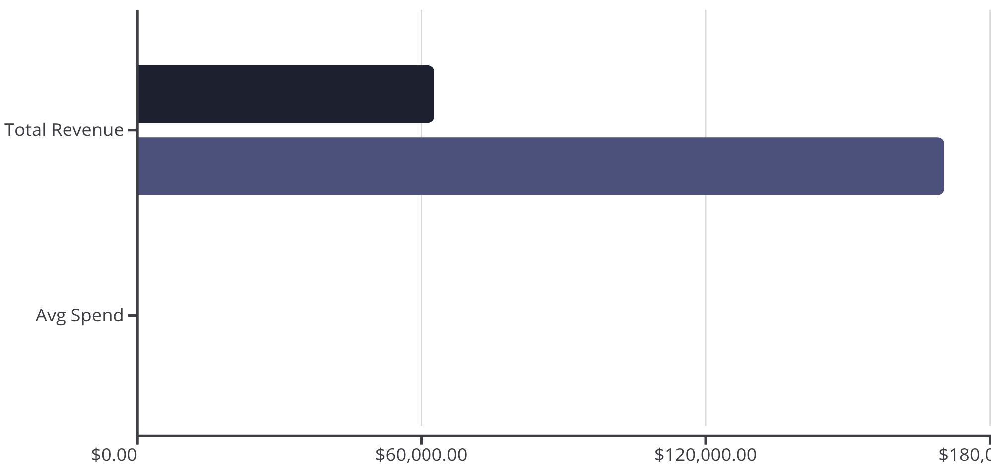
Subscription Status Comparison
1,053
Subscribers
27% of customer base
2,847
Subscribers
Non-Subscribers
Non-Subscribers
73% of customer base
While subscribers and non-subscribers show similar average spending patterns ($59.49 vs $59.87), the massive untapped potential lies in converting the 73% non-subscriber base. With 2,847 non-subscribers generating $170,436 in revenue, even a modest increase in subscription rate could significantly boost predictable recurring revenue.
Growth Opportunity: A 10% increase in subscription rate would add approximately 285 subscribers, potentially generating an additional $16,900+ in committed revenue

Slide 8



Customer Segmentation & Product Performance
Customer Loyalty Distribution
New Customers
1
83 customers (2.1%) - Recent first-time buyers
2
Returning Customers
701 customers (18.0%) - Made 2-5 purchases
3
Loyal Customers
3,116 customers (79.9%) - 5+ purchases, core revenue base
The customer base shows exceptional loyalty with nearly 80% classified as Loyal customers. However, the small New customer segment (2.1%) suggests potential challenges in customer acquisition that need addressing.
Top Products by Category
Accessories
Clothing
Footwear
Outerwear
Jewelry - 171 orders
Blouse - 171 orders
Sandals - 160 orders
Jacket - 163 orders
Sunglasses - 161 orders
Pants - 171 orders
Shoes - 150 orders
Coat - 161 orders
Belt - 161 orders
Shirt - 169 orders
Sneakers - 145 orders

Slide 9
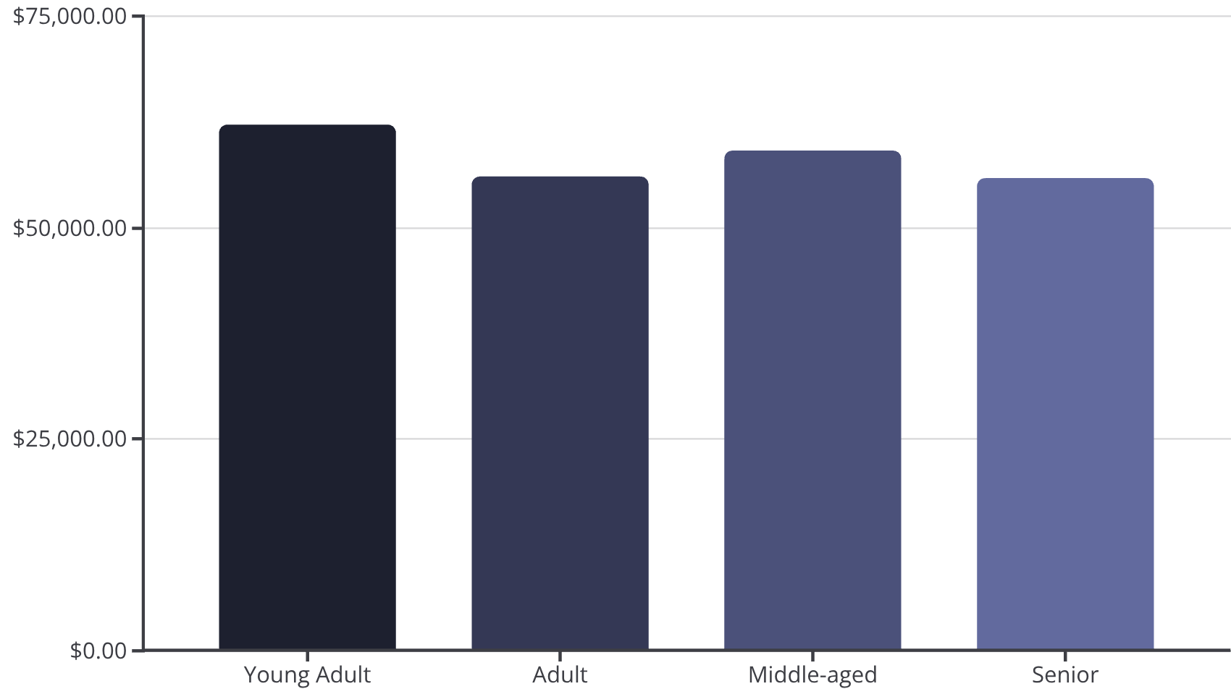
Discount Dependency & Age Group Revenue
Most Discount-Dependent Products
Revenue by Age Group
These products show the highest percentage of purchases made with discounts applied, revealing which items may require promotional support to drive sales:
50%
Hat
49.66%
Sneakers
49.07%
Coat
Young Adults lead revenue generation at $62,143, followed closely by Middle-aged customers at $59,197. Revenue is remarkably balanced across age groups, indicating broad market appeal.
48.17%
Sweater
47.37%
Pants
Nearly half of all purchases for these items involve discounts, suggesting potential pricing strategy issues or high price sensitivity in these categories.
Analysis of repeat buyers shows that among customers with more than 5 purchases, 958 are subscribers while 2,518 are not, revealing significant opportunity to convert loyal repeat buyers into subscription members.

Slide 10












Strategic Recommendations
Based on comprehensive analysis of 3,900 customer transactions, we've identified key opportunities to drive growth and optimize operations:
Boost Subscription Adoption
Enhance Customer Loyalty Programs
With 73% of customers as non-subscribers yet showing similar spending patterns, promote exclusive benefits, early access to products, and special pricing to convert the 2,847 non-subscribers. Target the 2,518 repeat buyers (5+ purchases) who aren't yet subscribed.
Reward repeat buyers to accelerate their journey from Returning (701 customers) to Loyal (3,116 customers) segments. Focus on the 839 high-value discount users who demonstrate strategic shopping behavior.
Review Discount Policy
Leverage Top-Rated Products
With products like Hats (50%), Sneakers (49.66%), and Coats (49.07%) showing high discount dependency, reassess pricing strategies to balance sales volume with margin protection. Consider value-based pricing instead of discount-driven sales.
Feature highest-rated products (Gloves 3.86, Sandals 3.84, Boots 3.82) prominently in marketing campaigns and product recommendations. Use customer testimonials and ratings to drive conversion.
Targeted Marketing by Demographics
Address Customer Acquisition
Focus marketing efforts on Young Adults ($62,143 revenue) and express-shipping users ($60.48 avg spend) who demonstrate higher value. Develop strategies to increase female customer engagement from current 32% revenue share.
With only 83 new customers (2.1%), invest in acquisition strategies to grow the customer base. The strong 79.9% loyal customer rate proves retention capability—now focus on bringing new customers into the funnel.

